Slide 1
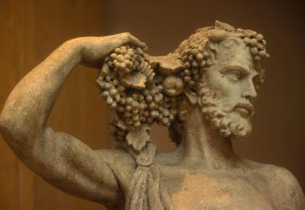
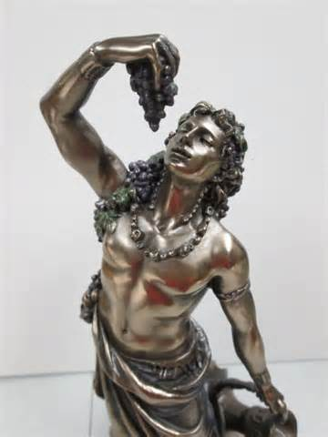
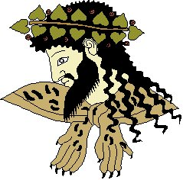
Dionysus
Zoe Brink

Slide 2
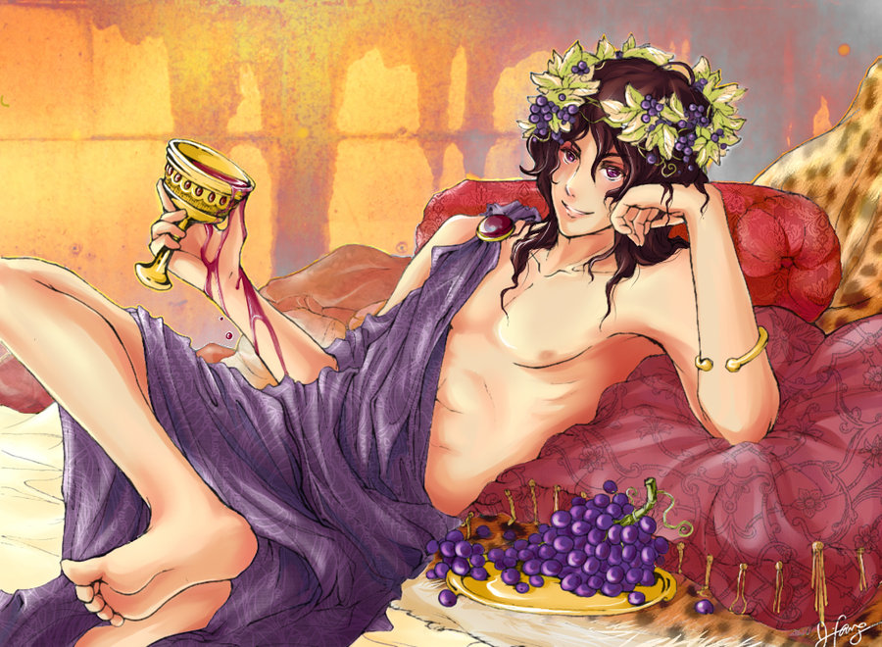
Who was he?
Parents were Semele (daughter of Cadmus) and Zeus OR Persephone and Zeus
A later created Olympian
Turned into the God of wine, ectasy, festivity, madness, and theatre
-associated with mysterious religious cults
-referred to as the “Bull Horned God” because one of his common forms is the bull
The only God who comes from a mortal parent

Slide 3
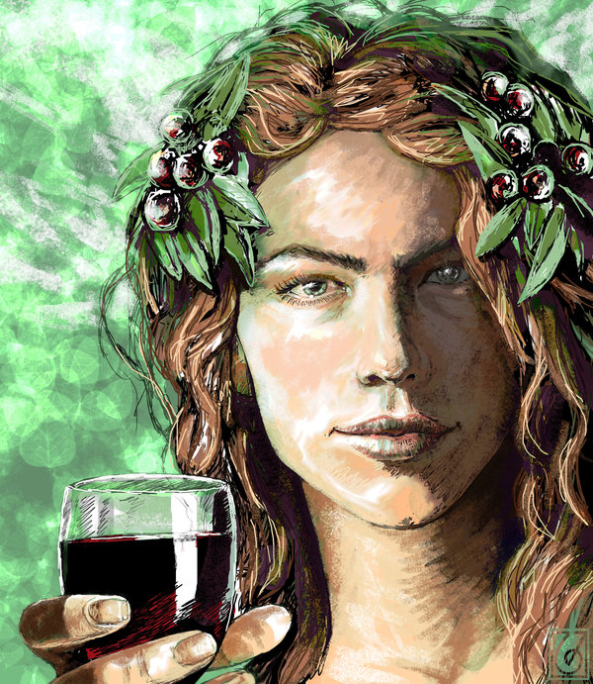
Adult Appearance
Dark, curly hair
Dark, curly beard
Depicted with grapes, ivy leaves, and wine
Carried the Thyrsus
-staff covered in vines

Slide 4
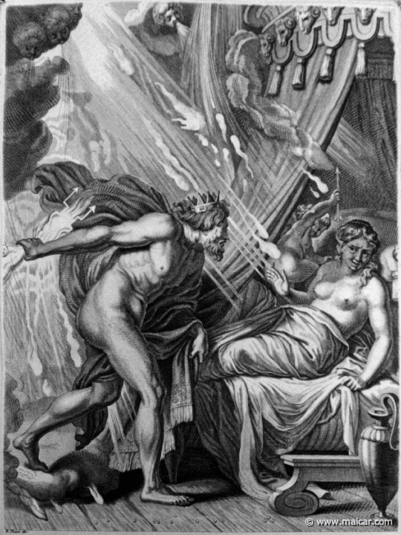
The Story of his Birth
One version:
-Zeus got with Semele and she was to give birth to Dionysus
-Hera convinced Semele to ask Zeus to reveal himself to her in his true form
-the intensity of Zeus’ power was too much
-thunderbolts struck Semele and killed her
-To save his son, Zeus removed Dionysus from Semele’s womb and put him in his thigh until Dionysus was mature enough to be born

Slide 5
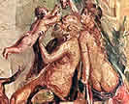
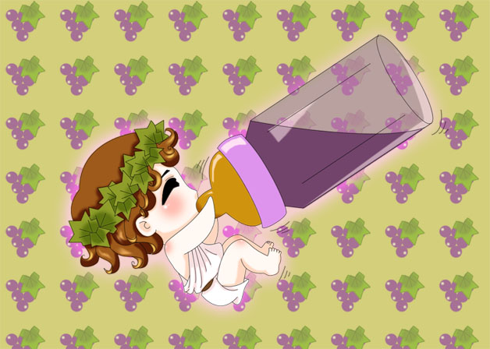
The story of his birth…continued
Second version:
-Zeus got with Persephone (Hades wife) and she was to give birth to Dionysus
-after Dionysus was born, Hera got the Titans to lure Dionysus to them with toys
-they ate all of baby Dionysus except his heart
-Contraversial: either Athena, Rhea, or Demeter saved him
-Zeus recreated Dionysus using his heart and implanted him into Semele
-she gave birth to the new Dionysus Zagreus

Slide 6
What happens next
-Zeus sent Dionysus to Mount Nysa to be protected from Hera
-Does not live on Olympus
-he lives with the Nymphs
-here, he invented the art of wine making
-he travelled the world with his partying followers (the maenads) spreading new techniques in wine making

Slide 7
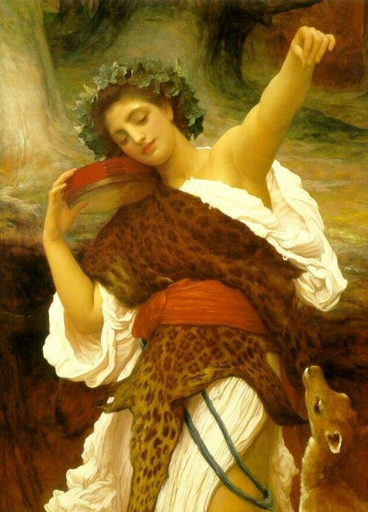
The Maenads
The female followers were called the Maenads
-most significant members of the Thiasus (Dionysus’ entourage)
-accompanied Dionysus in his travels
-name translates as “raving ones”
-they would often be depicted as drunk and wild
-in this state, they would hunt down and eat animals, men, and children

Slide 8
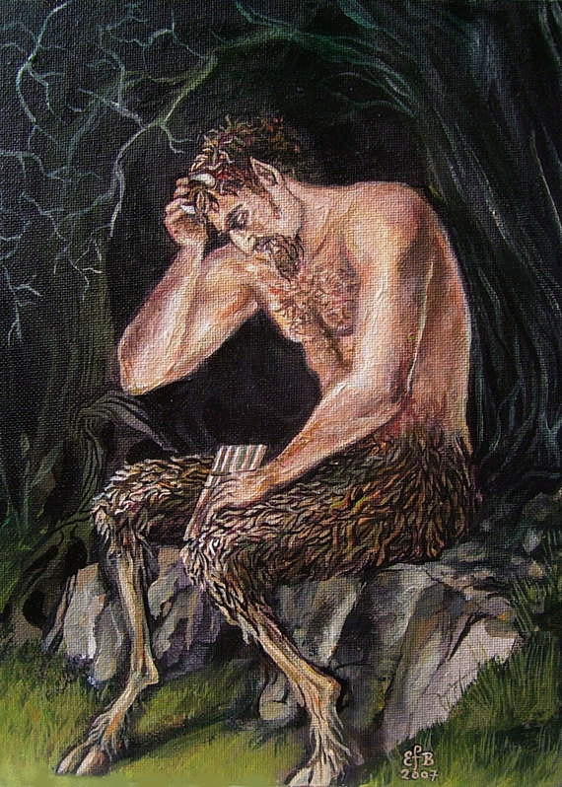
The Satyrs
These were the male followers of Dionysus
-animal like men
-usually seen drinking and dancing as well as playing tambourines and flutes (the instruments of the bacchic orgy)
-did not accompany Dionysus in his travels
-unlike the Maenads, they had several “favorite” Gods

Slide 9
Life
Dionysus married Ariadne (daughter of King Minos)
Had 6 children together
-despite his madness and love of wine, he was always faithful to Ariadne and they were happy
-it was uncommon for any God to be faithful

Slide 10
Specific Myths Associated with Dionysus
-The Wanderings of Dionysus
-tells the story of the adventures Dionysus experienced while spreading wine making techniques and his religious cult ideas

Slide 11
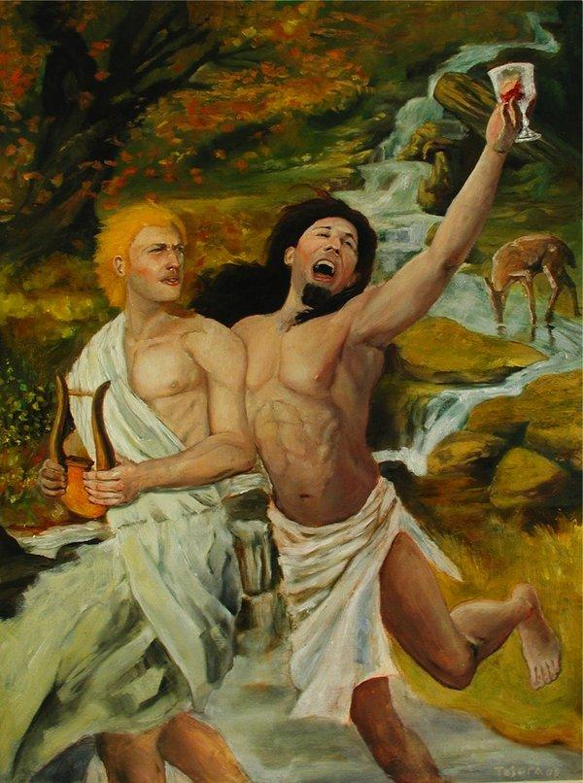
Modern Connections
-Wine is a very common alcoholic beverage
-Ariadne Auf Naxos by Richard Strauss (opera that tells the story of how Dionysus meets his wife)

Slide 12
Sources
http://www.princeton.edu/
http://www.theoi.com/Georgikos/Satyroi.html
http://www.pantheon.org/articles/d/Dionysus.html
http://www.gods-and-monsters.com

