Slide 1
Short Stories

Slide 2
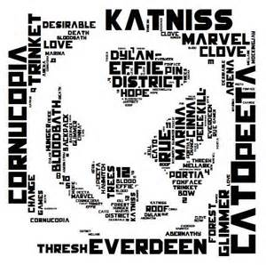
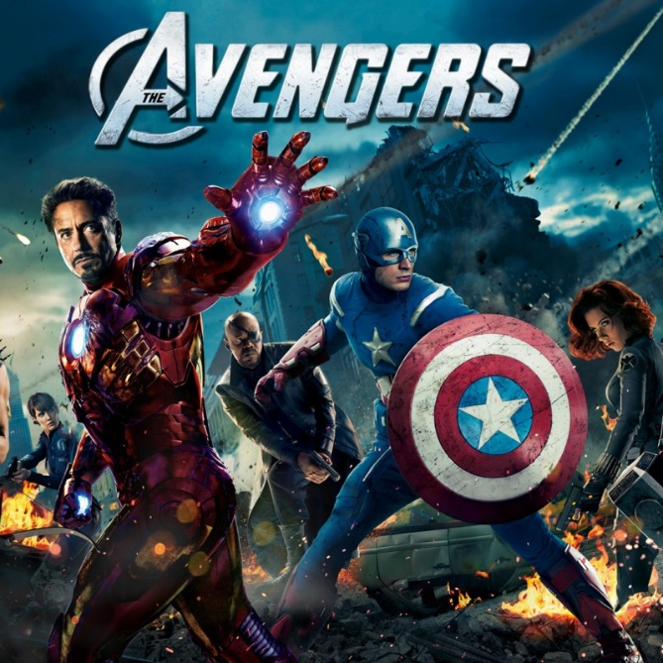
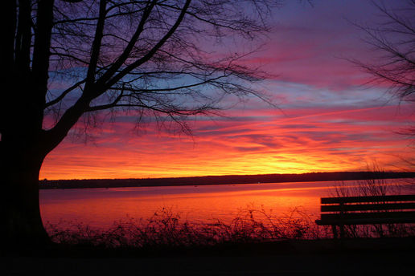
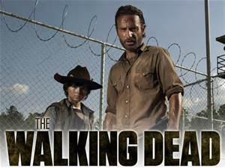
What is needed for a story?
Theme
Characters
Conflict
Plot
Setting

Slide 3
5 Main Components
Plot
Conflict
Characters
Setting
Theme

Slide 4
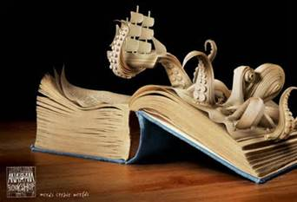
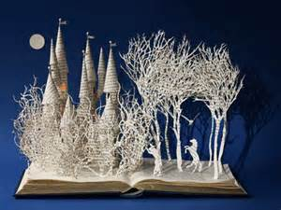
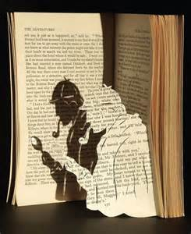
Plot
+ Series of events or circumstances
+ There is always a conflict of some kind in the main plot

Slide 5
The Story Thickens…
Exposition- beginning information about character, setting, etc.
Rising Action- events leading up to climax
Climax- the culminating point in the story where the conflict comes to a head, the turning point
Falling Action- events after the climax
Resolution- a satisfactory close to a conflict

Slide 6
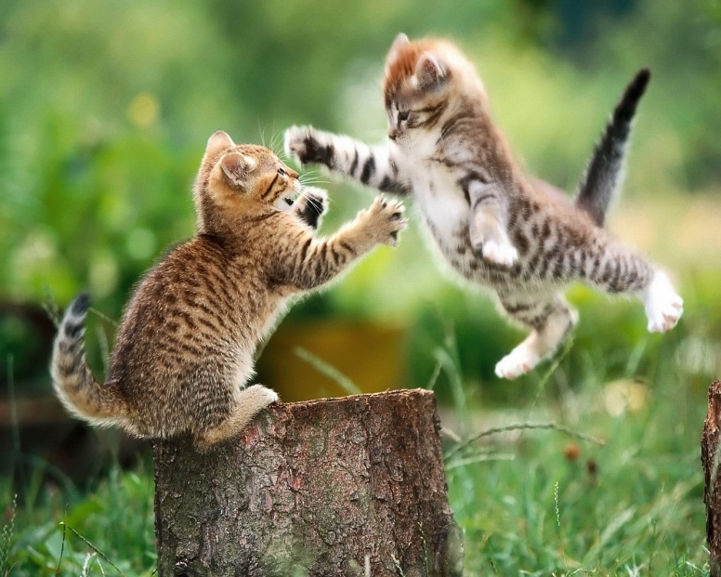
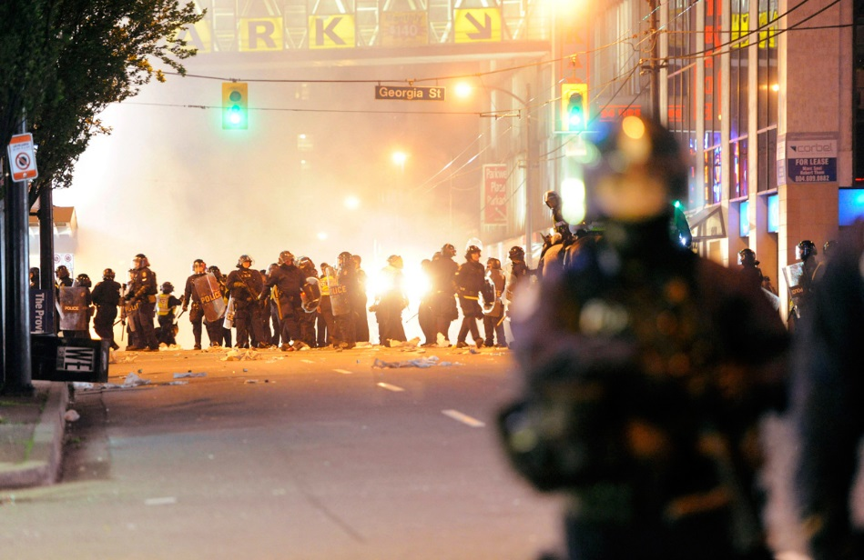
Conflict
The main problem or complication in the story

Slide 7
Conflict
External
Man vs. Man
Man vs. Nature
Internal
Man vs. Self

Slide 8
Characters
Protagonist
Antagonist
Conflict

Slide 9
3rd Person Omniscient
3rd person Limited
2nd person
1st Person
Point Of View

Slide 10
Flat
Static
Not known
Vague
Minor characters
Stays the same person throughout the story
Character
Round
Dynamic
Very detailed
Reader knows the character very well
Changes by the end of the story

Slide 11
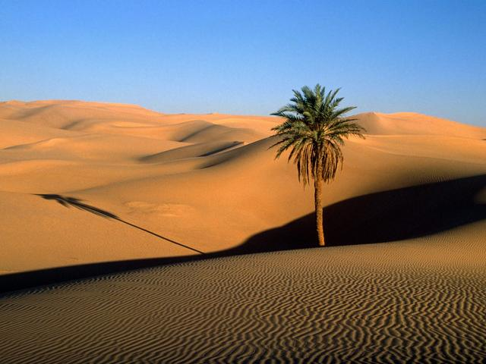
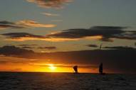
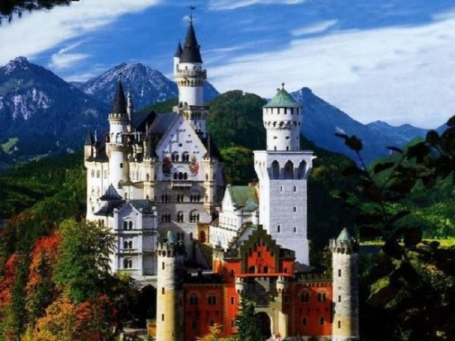
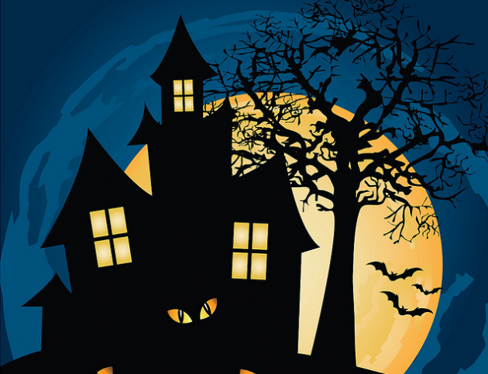
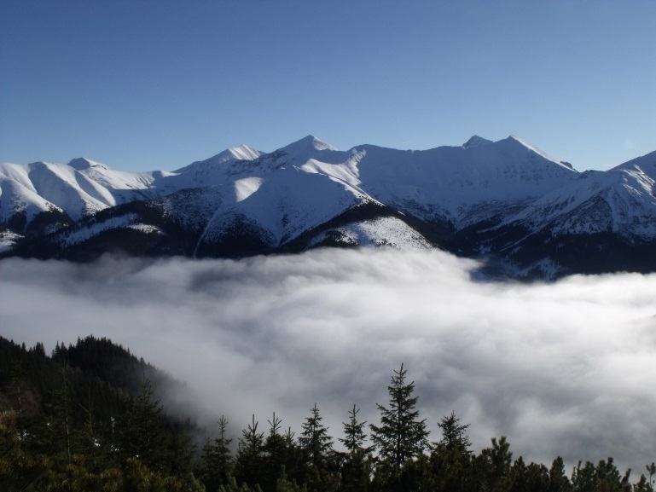
Setting
Time and place
When and where

Slide 12
Setting
Influences the character
Serves as a symbol
Creates conflict

Slide 13
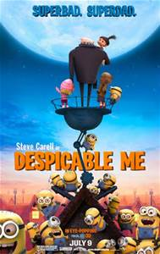
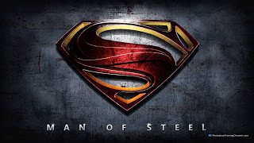
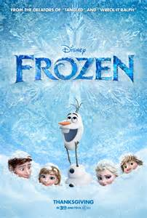
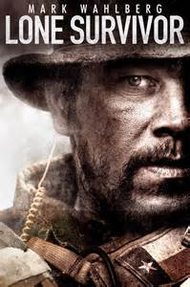
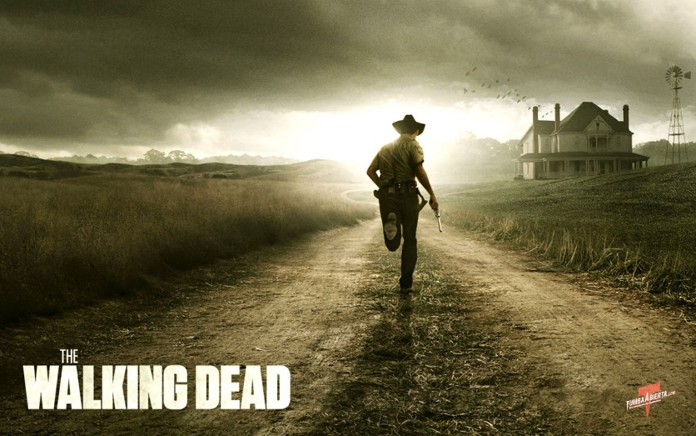
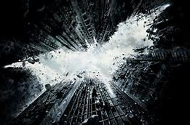
+ Meaning behind the story
+ What’s the big idea / purpose?
Theme

Slide 14
Mood vs. Tone
Mood
Tone
In a literary work, mood is the feeling or atmosphere that a writer creates for the reader. This can be established through many different things:
Figurative language
Imagery
Descriptive words
The attitude the author takes towards a subject. Tone reflects the feelings of the writer instead of just portraying the emotional response of the story.
Example: serious, humorous, formal, informal, somber

Slide 15
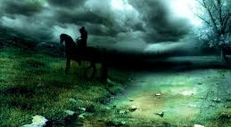
Mood

Slide 16
What is the mood?
Stark naked flower stalks
Stand shivering in the wind.
The cheerless sun hides its black light
Behind bleak, angry clouds,
While trees vainly try
To catch their escaping leaves.
Carpets of grass turn brown,
Blending morosely with the dreary day.
Winter seems the death of life forever.

Slide 17
How does the author feel about the topic he/she is writing about?
Mood: Gloomy
Tone: ???
Stark naked flower stalks
Stand shivering in the wind.
The cheerless sun hides its black light
Behind bleak, angry clouds,
While trees vainly try
To catch their escaping leaves.
Carpets of grass turn brown,
Blending morosely with the dreary day.
Winter seems the death of life forever.

Slide 18
Other Literary Terms

Slide 19
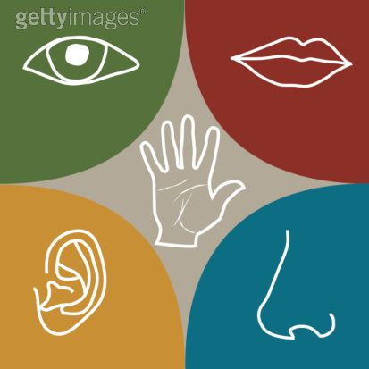
Imagery
Descriptive words and phrases that describe something using the five senses—sight, hearing, smell, taste, and touch.

Slide 20
Describe it…
Taste: What did it taste like?
Smell: What kind of smell?
Hearing: What did you hear?
Sight: What did you see?
Touch: What did it feel like?

Slide 21
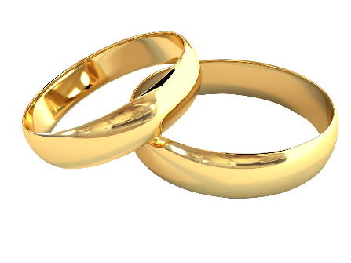
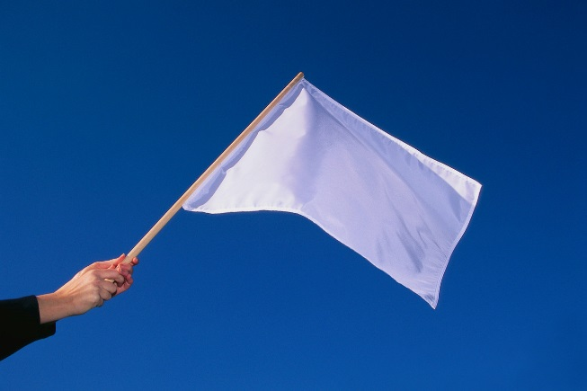
Symbolism
A symbol is a person, place, object, or an activity that stands for something beyond itself.
A flag is a colored piece of cloth that stands for a country
White dove stands for peace
Lion stands for courage while snakes symbolize sneakiness/untrustworthy

Slide 22
Other Symbols…
What other symbols do you see or know?
Talk amongst your classmates and think of 3 more symbols in everyday life

