Slide 1
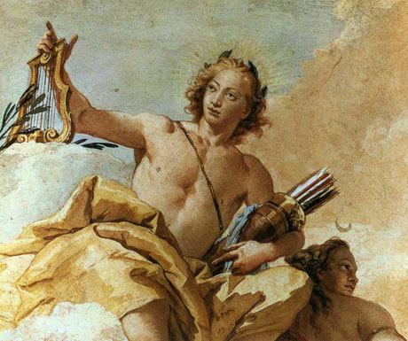
Apollo
The God of Music

Slide 2
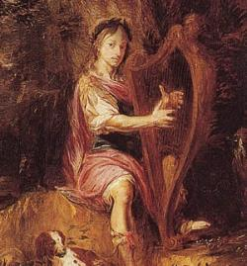
Functions of Apollo
God of: music, light, healing, truth, poetry, and dance
Plays a golden lyre
Taught man medicine
Destroyer of rats and locust

Slide 3
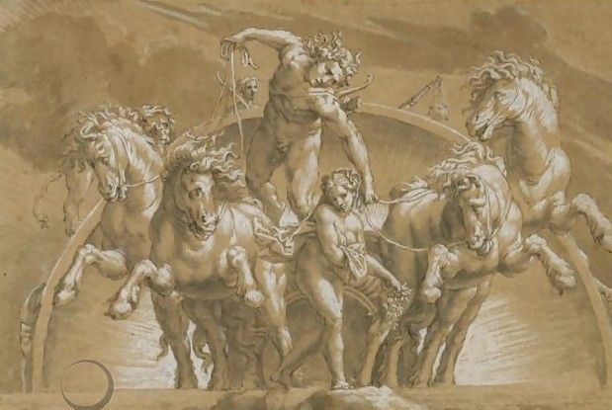
Apollo’s Daily Task
Harnesses his chariot with four horses and drives the sun across the sky

Slide 4
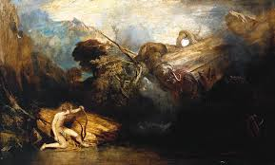
Myths About Apollo
Fights the monstrous python for Leto
Apollo’s wedding proposal
The birth of Apollo and Artemis
Apollo’s oracle at Delphi

Slide 5
Apollo fights
Monstrous Python

Slide 6
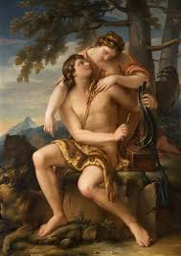
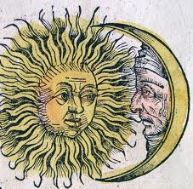
Apollo’s Relationships
The son of Zeus and Leto
Twin sister of Artemis
Artemis is the goddess of the moon and the hunt (opposite of Apollo)

Slide 7
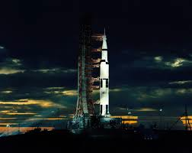
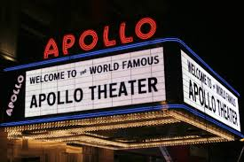
Modern Allusions to Apollo
Apollo space missions named after the Greek god
Apollo music hall called the Apollo Theatre in NYC

Slide 8
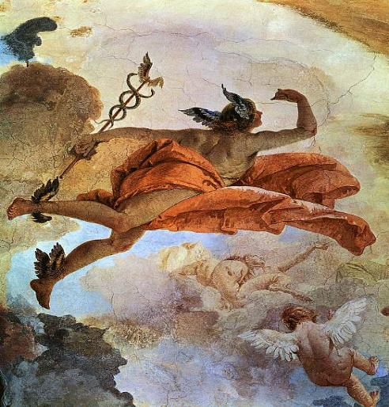
Caduceus

