Slide 1
George orwell and animal farm

Slide 2
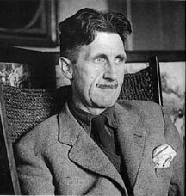
The Author
George Orwell (pen name)
Eric High Blair is George Orwell’s birth name.
He was born in India in 1903. His father served as a minor government official there.

Slide 3
The Author
When Orwell was eight he was sent to a prep school in England. Although his father was a government official, his family did not have a lot of money. Because of this, Orwell was allowed to go to the school at a reduced rate. Orwell’s classmates treated him poorly because his family was not as wealthy as the other students in the school.
Because of this treatment, it is said that Orwell often identifies with the underdog.

Slide 4
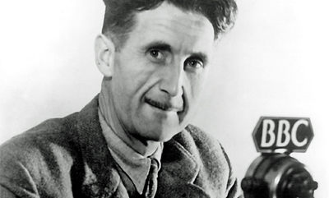
The Author
After his schooling, Orwell worked for the Indian Imperial Police in Burma for several years.
Next, Orwell and his wife moved to Paris, and he began to focus on his writing.

Slide 5
The Author
George Orwell was originally in favor of the communist movement because times were tough and it seemed to be a way to make conditions more equal for people. In fact, he got caught up in all of the hype, but when people began to abuse their power, he had a real problem with it.
Orwell became very angry about the way people were being treated in communist Russia under Stalin’s rule.

Slide 6
The Author
Because Orwell did not have the luxury of freedom of speech, he wrote an allegory using animals to represent what was happening in the countries.
Allegory- a story in which the characters or events represent real-life people, ideas, or historical happenings.
http://www.youtube.com/watch?v=l3iXy-I2PEg

Slide 7
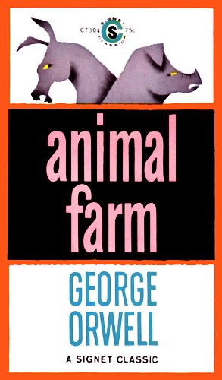
Animal Farm
The result of Orwell’s writing is Animal Farm.
Animal Farm is a story written in the allegorical form the represents many of the people and happenings associated with the Russian Revolution and the years following from 1917 to 1943.

Slide 8
Animal Farm
All of the characters and happenings in Animal Farm represent someone or something that happened.
http://www.youtube.com/watch?v=vXhi0eaR0-c&feature=relmfu

